Slide 1
VOICE prescription
Project by : all-day solvers
Team leader: Ayesha ashraf sultana
Team members : hemashree kilari
Harshavardhan
Tanmai
Rahul bolineni
Ram kishore

Slide 2
MINISTRY/ORGANISATION NAME:
BAJAJ FINSERV
PROBLEM STATEMENT :
Voice Prescription

Slide 3
Idea of the project:
The main idea of the project is to develop a software which listens to what the doctors say in order to create a PDF of a prescription that has the patient's details as well as the problem and the medication required.
We then send the PDF created using WhatsApp.
A GUI is present for the convenience of the doctor to view or correct the details that he/she has given .
The doctor can correct the errors if any through speech or keyboard
This GUI has buttons performing different functions

Slide 4
Technology stack :
We coded this software using Python 3.8
For the GUI ,we used tkinter.
To convert the speech of the doctor to text google API has been used.
Selenium has also been used to manipulate the web browser . In this case we used it to control “WhatsApp”

Slide 5
Use cases :
This application is used by doctors to voice their prescription instead of typing it or writing it on paper.
Through this the doctor does not have to get his/her prescription template printed.
The pdf created by this application which is a prescription has the hospital details as well as the doctor's sign .
Only if the doctor’s signature is present in the system being used, it can be inserted in the prescription.

Slide 6
Dependencies of our APPLICATION:
We will require internet connection for the application to work.
We have used some libraries like tkinter, speech recognition, fpdf etc.
We will also require the doctor's signature’s image in the system.

Slide 7
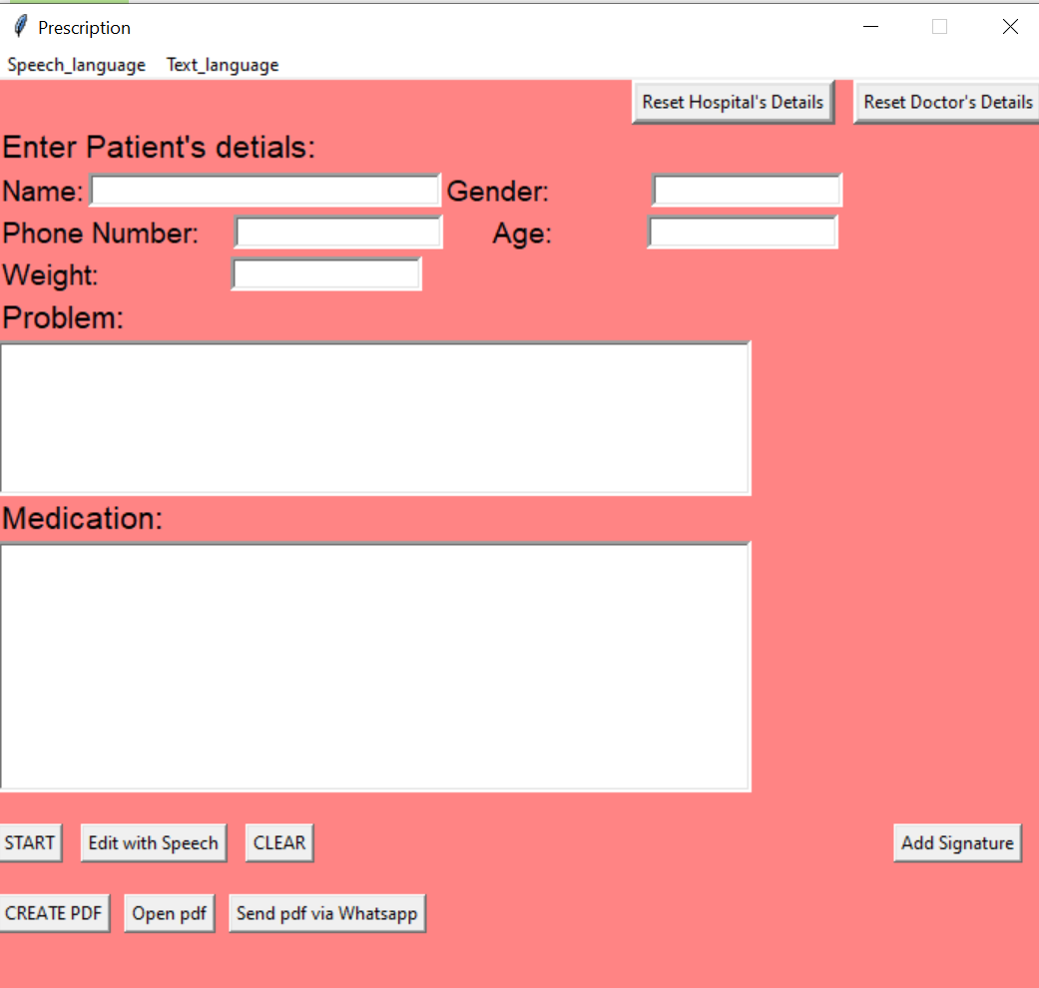
G u I

Slide 8
BRIEF WORKING OF THE APPLICATION
The interface has been developed using tkinter module. Doctor must press the “start” button in order to let the application start recognizing his/her commands and fill the details into respective fields.
If in case we must edit the already entered patient details in the form, it can be done either manually or by using “Edit with Speech button” that uses voice recognition to update the data.
Initially, the details of the hospital and the doctor have to be set so that a proper format of a prescription can be produced with name of the hospital as its header. If those details are to be modified, it can be done using the buttons “Reset Hospital’s Details” and “Reset Doctor’s Details”.

Slide 9
After filling in all the details regarding a particular patient, the doctor must click “Create PDF” button to generate the prescription with the details specified above as a PDF document .
This document is saved on the name of the patient in the system.
It is necessary for a Prescription to be signed by the doctor.
So an “Add Signature” button is used to add the image of the doctor’s signature to the prescription.
A “Send using WhatsApp” button has been included which is used to send the generated PDF document to the patient’s WhatsApp Number.
In order to clear all the previously entered patient details in the form, a “clear” button is used.
If the doctor would like to recheck the created PDF, he can do so by clicking the “Open PDF” button.

Slide 10
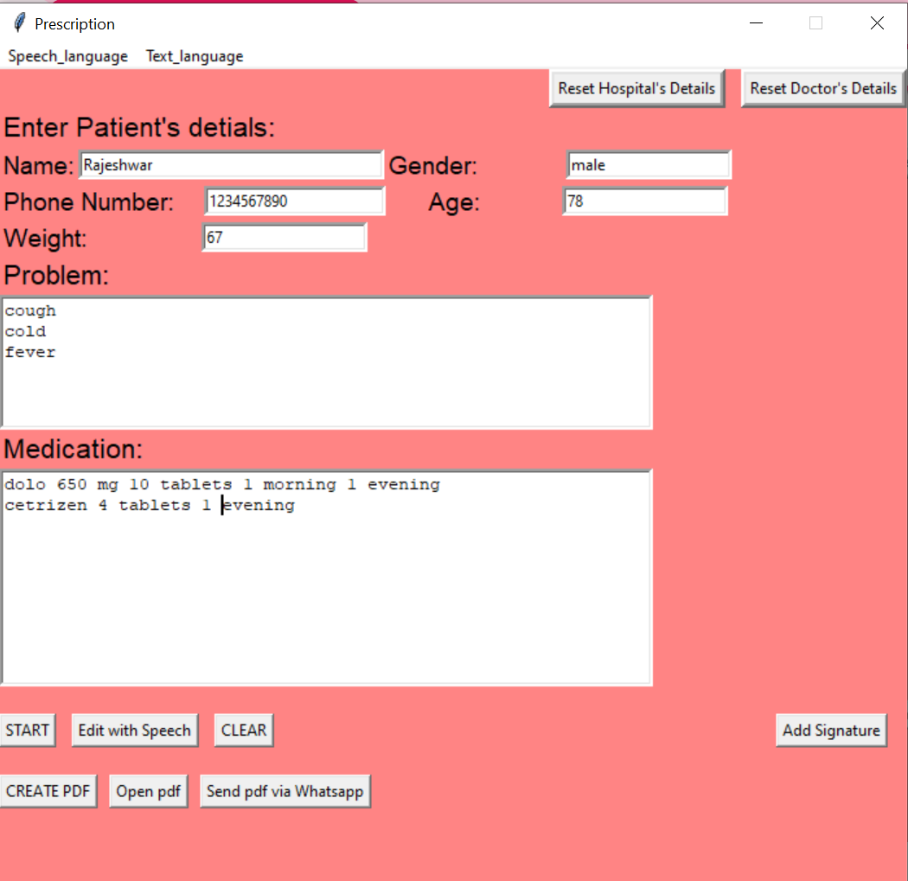
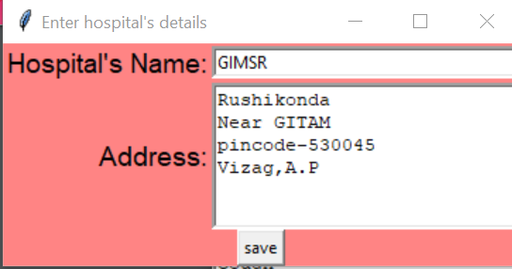
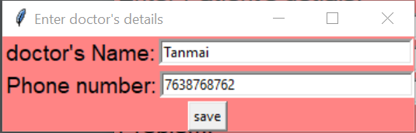
GUI AFTER FILLING THE Details :

Slide 11
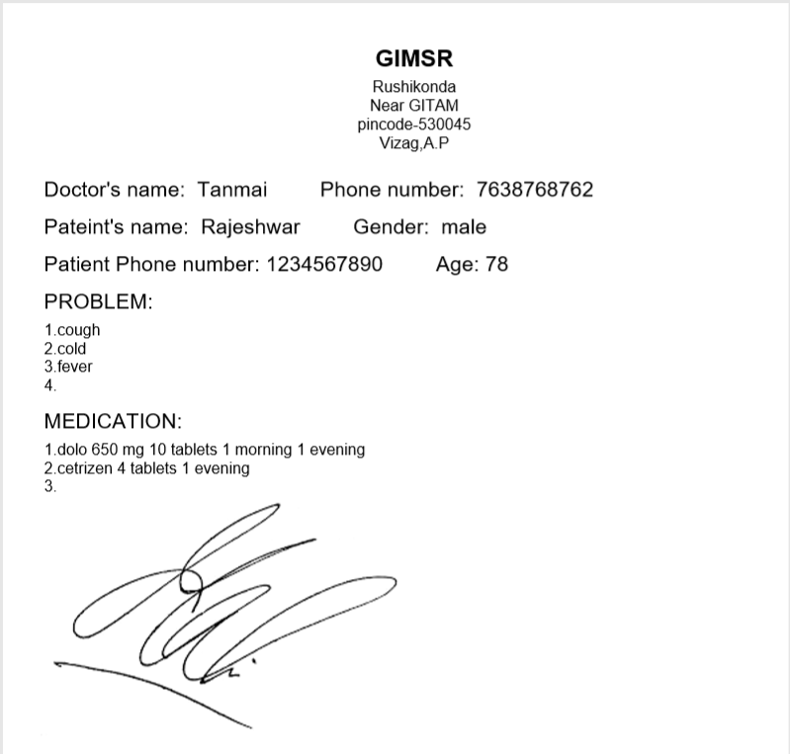
PRESCRIPTION OF THE PATIENT

Slide 12
REAL WORLD APPROACH:
This application can be used by doctors very easily.
It does not have a heavy operating procedure .
The doctor just has to click a button and speak.
Also it is useful for the patients visiting the doctor because they need not maintain a hard copy of the prescription because they have it in their mobile phones.
It is an open-source application and the packages used are also open sources.
The .exe file of this software can be given to the doctor, the doctor does not have to download any of the libraries or packages separately.

Slide 13
THANK YOU

